Slide 1
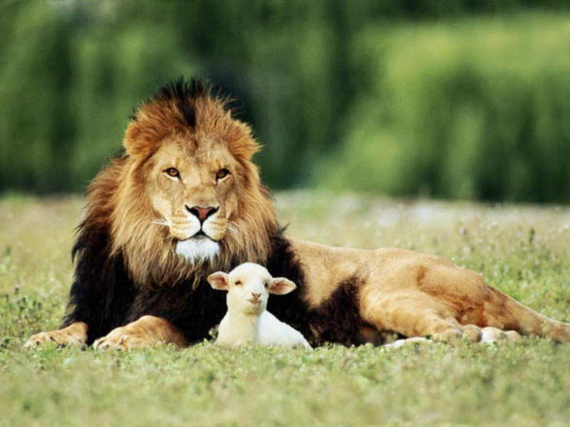
Things God Didn't Join Together

Slide 2
Righteous - Self-righteous
Righteousness that God provides
Overly wise
Righteous defined
Romans Chap. 10
Solomon - Eccl. 7:16-17
It is crazy to think you can be just a little wicked and still be all right, just as long as you don't cross the line.
"The character or quality of being right or just" (W. E. Vine)
A state or condition necessary to salvation
2 kinds of righteousness listed
Remember 2 other things discussed
Way of driving home point
Talking about sudo-righteousness/false piety
Doesn't mean you can overdue in pursuit of righteousness
Righteousness devised by man
Overly wicked

Slide 3
Church Roll -Lamb's Book of Life
Some draw conclusion that on church roll, therefore name in Lambs Book of Life
Granted, church membership is essential
Present church to Himself - Eph. 5:25-27
"... His body, which is the church" - Col 1:24
His body is church - Eph. 1:22-23
"We are many members in one body" - Rom. 12:4

Slide 4
Church Roll -Lamb's Book of Life
But may be member of local church and still be hypocrite
Sometimes get into trouble with local & universal
Man can fool man, but cannot fool God
Parable of wheat and tares - Matt. 13:24ff

Slide 5
Going To Church - Engaging In Worship
God is Spirit - Jn 4:24
Need to understand “going to church” doesn't mean worship
Some go to be seen of men
Do thing in secret - Matt. 5:1-18
Pharisee praying - Lk. 18:9

Slide 6
Age - Wisdom
Friends of Job
People feel because young, must have absence of wisdom - NOT SO
Being sarcastic
When you die, wisdom will be gone
“Let no one look down on your youthfulness...” - 1 Tim. 4:12
“If any of you lacks wisdom, let him ask…” - Jas 1:5

Slide 7
Sufficiently Interested In Self - Selfishness
Everyone should be concerned about self
Only way to proceed safely is to acquire blessings of Christ
Need to realize spiritual plight without Gospel

Slide 8
Sufficiently Interested In Self - Selfishness
Sin is selfishness - Jas 4:3; 1:13-15
Self-esteem can get you into trouble when person thinks he is better than he is
Only cares about own wants
Doesn't care how affects others
We place too much emphasis on self-esteem
Esteem others better than self - Phil. 2:3

Slide 9
Traditions Of Men - Traditions Of God
Must differentiate
I better be careful about what I advocate
2 Thess.3:6
Matt. 15:8-9 - Quote from Isa. 29:13
Not someone else do for me
Tradition of men?
Tradition of God?
Catholic Church misses point when say long standing practice
W. E. Vine - "A handing down ... in 2 Thess. 3:6, it is used of instructions concerning everyday conduct."
Greek word means precept (Strong)
Has nothing to do with things that have been going on a long time

Slide 10
God's Plan of Salvation
GOD'S PART
The great love of God for man (Jn 3:16)
He gave His Son, Jesus Christ, as the Savior (Lk 19:10)
Sent the Holy Spirit as a guide (Jn 16:13)
Gave the Gospel as "the power" unto salvation (Rom 1:16)
Provided atonement by the blood of Christ (Rom 5:9)
MAN'S PART
Hear the Gospel (Rom 10:17, Jn 8:32)
Believe the Gospel (Heb 11:6, Jn 20:31)
Repent of past sins (Lk 13:3, Acts 17:30)
Confess faith in Jesus Christ (Rom 10:10, Matt 10:32)
Be Baptized (Gal 3:27, Mk 16:16, Acts 2:38)
Be faithful unto death (Rev 2:10)
God has done His part. Have you done yours?

